Slide 2
Next Generation GoldenGate(12c) vs. Streams for Physics Data
Zbigniew Baranowski - CERN

Slide 3

Outline
About CERN
CERN’s replication service based on Streams
Evaluation of GoldenGate…
…including the latest version
Summary

Slide 4
Outline
About CERN
CERN’s replication service based on Streams
Evaluation of GoldenGate…
…including the latest version
Summary

Slide 5
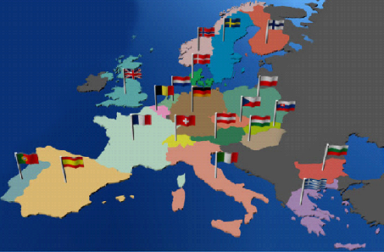
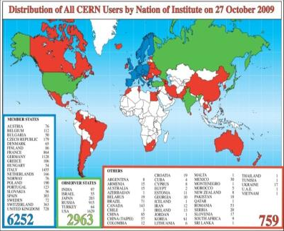
CERN
European Organization for Nuclear Research founded in 1954
20 Member States, 7 Observer States + UNESCO and UE
60 Non-member States collaborate with CERN
2400 staff members work at CERN as personnel, 10 000 more researchers from institutes world-wide

Slide 6
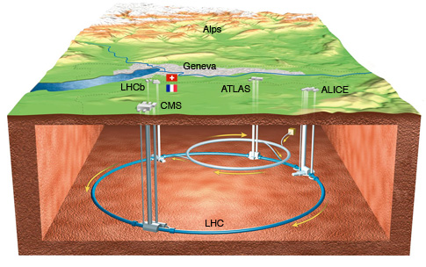
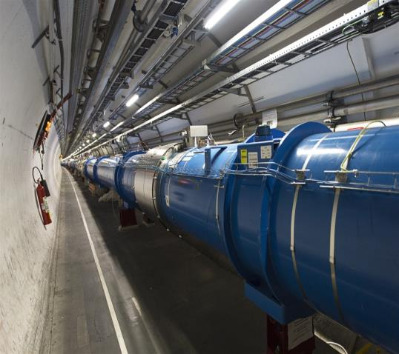
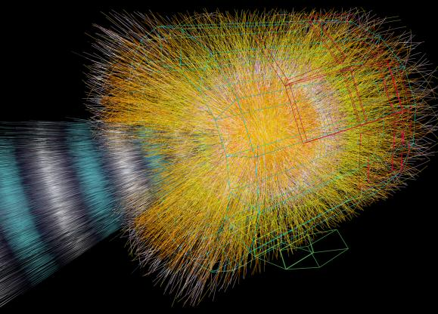
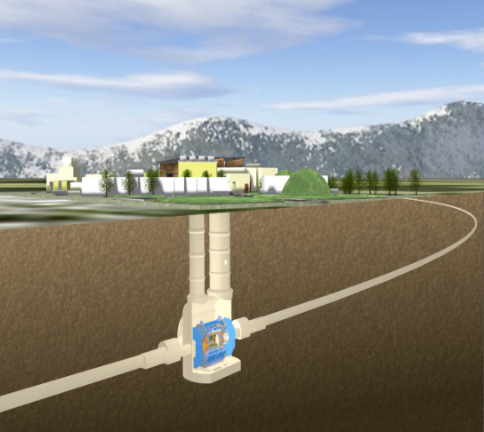
LHC, Experiments, Physics
Large Hadron Collider (LHC)
  World’s largest and most powerful particle accelerator
  27-kilometre ring of superconducting magnets
  Currently undergoing upgrades, restart in 2015
The products of particle collisions are captured by complex detectors and analyzed by software in the experiments dedicated to LHC
Higgs boson discovered!
Notes:
New particle discovery: see also CMS and Atlas announcement on July 4th 2012.

Slide 7
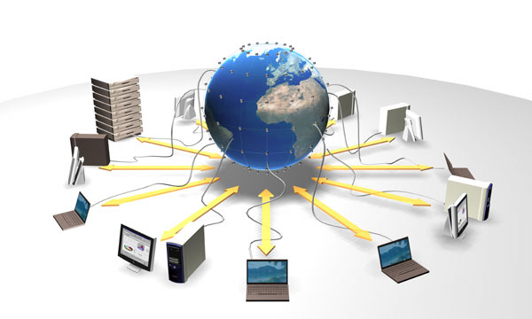
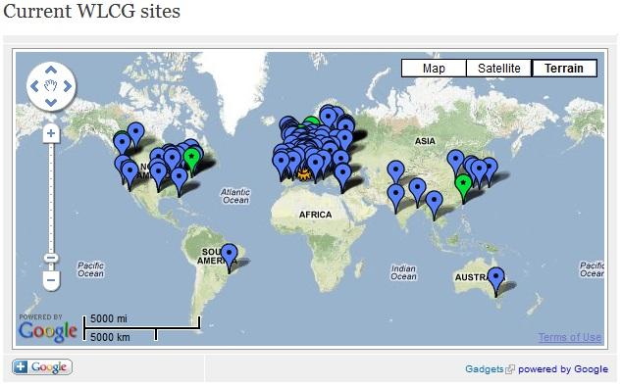
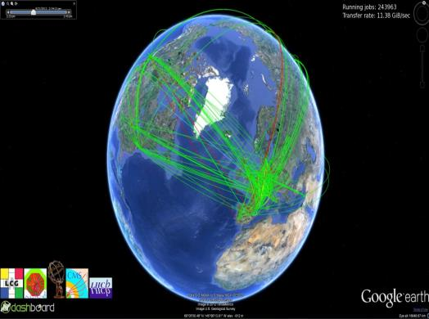
WLCG
The world’s largest computing grid
  More than 20 Petabytes
  of data stored and analysed every year
  Over 68 000 physical CPUs
  Over 305 000 logical CPUs
  157 computer centres in 36 countries
  More than 8000 physicists with real-time access to LHC data

Slide 8
Outline
About CERN
CERN’s replication service based on Streams
Evaluation of GoldenGate…
…including the latest version
Summary

Slide 9
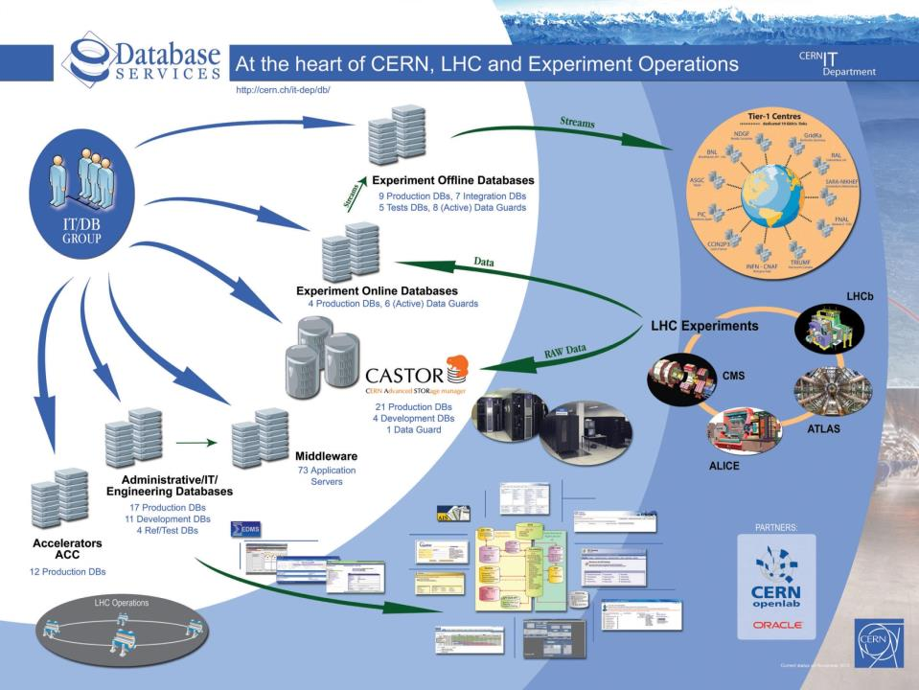
Notes:
We have over 100 databases grouped in different areas

Slide 10
What do we replicate SQL-based?
PVSS - Supervisory Control And Data Acquisition (SCADA)
  control data from LHC hardware components (ICS)
  DDL and DML operations
  4TB of data, 81% of source db, average workload : 700 row changes /s
Experiments conditions data
  record the state of the detector: calibration, alignment, environmental parameters, … (DDL and DML operations)
  900 GB of data, 8% of source db, avg workload 50 row changes /s
Other:
  Muon calibration data (DML & DDL); 72 GB
  ATLAS Metadata Interface (DML & DDL); 80 GB
Notes:
conditions data are any detector conditions, as well as any other experimental area condition data, that can be used to characterize the status of the detector. Examples are data from calibration, alignment, geometry, environmental parameters (temperature, pressure, etc.), any slow control parameter.
Conditions data are needed by reconstruction and analysis programs in order to reconstruct the events from the raw event data, and to further analyse
this data.

Slide 11



Oracle Streams Replication
Technology for sharing information between databases
Database changes captured from the redo-log and propagated asynchronously as Logical Change Records (LCRs)
Source
Database
Target
Database
Propagate
Redo Logs
Capture
Apply

Slide 12

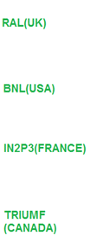

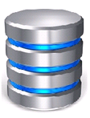
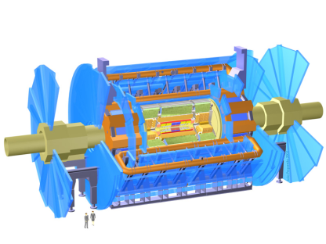
Streams Setups @CERN
Downstream
Capture
Database
Conditions
Online
Database
Offline
Database
Conditions
Conditions
REDO
Conditions
PVSS
Conditions
UMICH
(USA)
ROME
(ITALY)
MUNICH
(GERMANY)
IN2P3
(FRANCE)

Slide 13
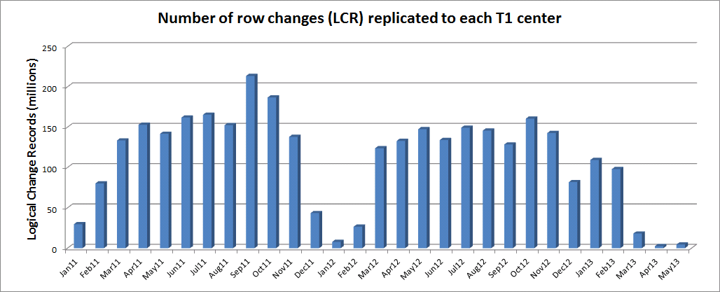
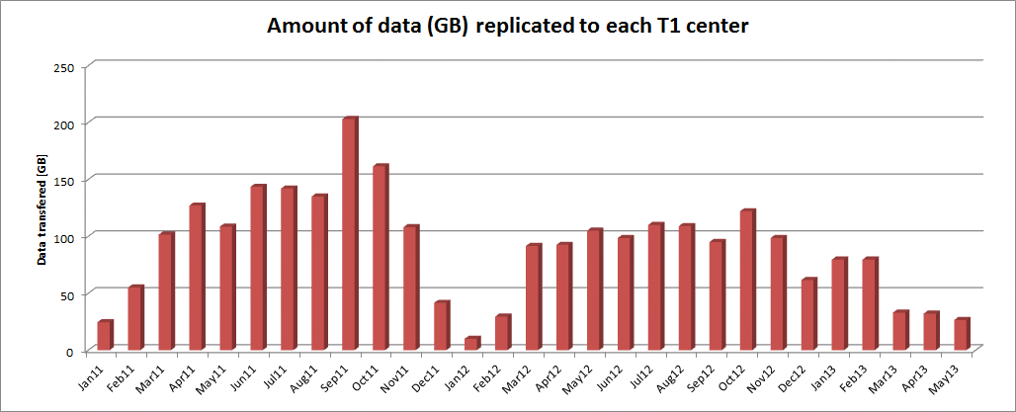
Streams Setups @CERN
LHC technical stop
LHC long shutdown
Notes:
conditions data are any detector conditions, as well as any other experimental area condition data, that can be used to characterize the status of the detector. Examples are data from calibration, alignment, geometry, environmental parameters (temperature, pressure, etc.), any slow control parameter.
Conditions data are needed by reconstruction and analysis programs in order to reconstruct the events from the raw event data, and to further analyse
this data.

Slide 14

Streams Monitoring
In-house tool for Streams monitoring: STRMMON
  Process state (Mail & SMS notifications)
  LCR’s throughput
  Replication latency (Mail & SMS notifications)
  Topology
  Long running transactions
  Streams pool utilization
  Cluster load
Oracle Enterprise Manager
  Streams monitoring enhancements since 10.2.0.5
Streams performance advisor (SPADV) and health check script
Notes:
Features:
Streams topology
Status of streams connections
Error notifications
Streams performance (latency, throughput, etc.)
Other resources related to the streams performance (streams pool memory, redo generation)

Slide 15
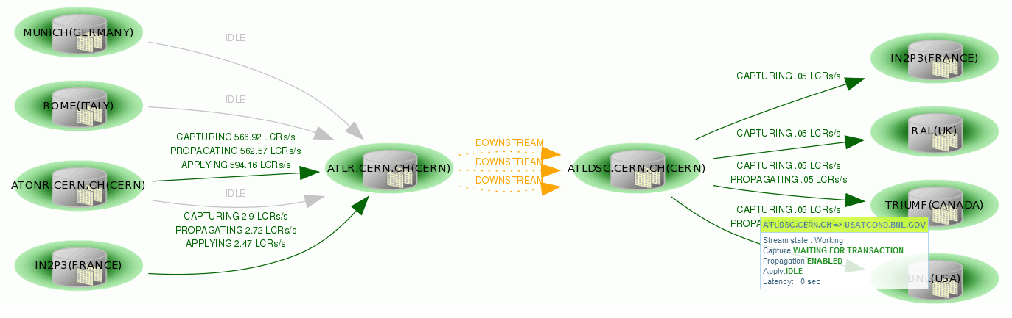
CERN’s Streams Monitor

Slide 16
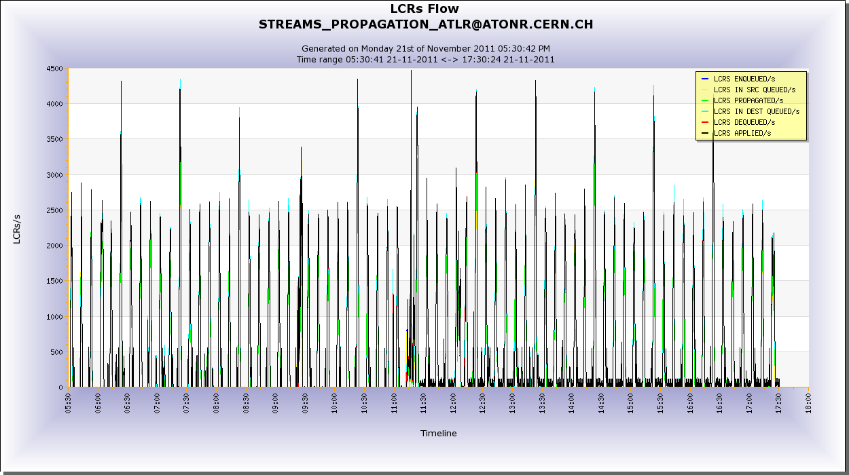
CERN’s Streams Monitor

Slide 17
Replica Resynchronization
Broken site is out of the Streams recovery window
Using Transportable Tablespaces
Stop replication to one of the sites
Use this site to recover the broken one (TT)
Split replication and recover lagging replicas
Merge both replication
Source Database
Target Databases
3
1
2
A
A
A
4
5
C
A
A
3
A
5
A
Notes:
Complete transfer of data (schemas and tables) using Oracle Data Pump might take too long
Transportable Tablespaces: move a set of tablespaces from one Oracle database to another
Export metadata of tablespace instead of data in tablespace
But tablespaces must be in read-only while the data is copied
Procedure developed to use one replica in other to instantiate the target site

Slide 18
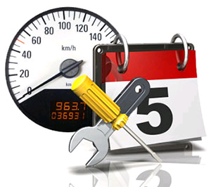
Periodic Maintenance
Dump fresh copy of Dictionary to redo
  reduces the amount of logs to be processed in case of additional process creation or recreation
  frequency: every day
Shrink Logminer checkpoint table
  improves capture performance
  frequency: every week
  Doc ID 429599.1
Review the list of specific Streams patches
  Doc ID 437838.1

Slide 19

Lessons Learned
Use heartbeat table to validate replication
SQL bulk operations (at the source db) processing using session tagging
Performance impact of long transactions (non-frequent commits)
Avoid using system generated names
Grantee must exist at all destinations
Protect schemas against reckless DDL
  use reader, writer accounts and lock objects owner
Notes:
SQL bulk operations (at the source db)
may map to many elementary operations at the destination side
need to control source rates to avoid overloading
Batch processing
minimize the performance impact using Streams tags
avoid changes being captured, then run same batch load on all destination
System generated names
do not allow system generated names for constraints and indexes
modifications will fail at the replicated site
storage clauses also may cause some issues if the target sites are not identical
Replication of “grant” operations
grants on views, PL/SQL procedures, functions and packages are NOT replicated
grantee must exist at all destinations
Long transactions (non-frequent commits)
Total number of outstanding LCRs is too large
LCRs are in memory too long
LCRs are spilled over to disk
Apply performance is impacted
All LCRs in a single transaction must be applied by one apply server
Parallel servers cannot be used efficiently
Too many unbrowsed messages enables flow control
Streams processes are paused
Apply oldest_message_number is not updated
caused by an old transaction not correctly removed from the apply spill table
dba_apply_spill_txn view in order to identify the transaction
set the apply parameter _IGNORE_TRANSACTION with the transaction id in the apply spill over queue
run purge_spill_txn procedure (metalink note 556183.1)
Apply might degrade performance when applying transactions to tables > 10M rows

Slide 20
Outline
About CERN
CERN’s replication service based on Streams
Evaluation of GoldenGate…
…including the latest version
Summary

Slide 21
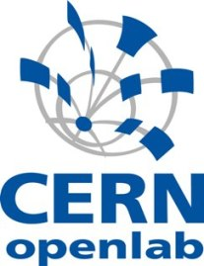
GoldenGate @CERN
CERN since 2010 intensively evaluates GG
  GG is the recommended SQL-based replication technology by Oracle
    Streams is in maintenance mode
  Active Data Guard does not apply in all cases
    partial database replication to remote sites

Slide 22

GG architecture (2010)
Source
Database
Target
Database
Redo Logs
Extract
Replicat
Datapump
Trail Files
Trail Files

Slide 23



Streams11g vs GoldenGate 11.1 in 2011
Trail files instead of buffer queues
  Decoupling source and target database
  Archive logs not needed for replaying data change stream
Very stable
More data types supported
Poor (worse than Streams) performance measured at CERN
    parallel delivery is not coordinated – constraints violation
    BatchSQL is not efficient for CERN workloads
No solution for remote (downstream) redo mining
DDL trigger deployment needed at source databases
No advanced monitoring solution available
CERN decided to
  Keep using Streams for remote data centres
  Migrate local replicas to Active Data Guard

Slide 24

Streams11g@CERN
Deployed in February 2012
  10g -> 11g was a painful process
Big improvement
  Better performance
  Better stability => less incidents
Combined capture and apply
  Optimised data flow control
  Automatic blacklisting and recovery of an unavailable replica

Slide 25
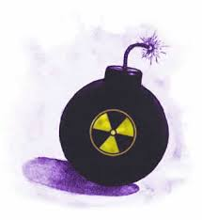
Some issues with Streams11g
Creation of temporary tables by Segment Advisor has to be filtered out in capture rules.
  Doc ID 1082323.1
Problems with restabilising of interrupted connection
  ORA-2685: Unable to connect to apply….
  Restart of an apply process needed
After restart capture process starts mining from the earliest redo log available when communication with replica is broken

Slide 26
Outline
About CERN
CERN’s replication service based on Streams
Evaluation of GoldenGate…
…including the latest version
Summary

Slide 27
We are happy with Streams but…
No new features
At the same time GoldenGate is evolving…

Slide 28
GG architecture (2010)
Source
Database
Target
Database
Redo Logs
Extract
Replicat
Datapump
Trail Files
Trail Files

Slide 29
Evolution of GG architecture (2011)
Source
Database
Target
Database
Logmining
Server
Redo Logs
Extract
Integrated
Extract
Replicat
Datapump
Trail Files
Trail Files

Slide 30

Integrated Replicat (2013)
Source
Database
Target
Database
Logmining
Server
Apply
Redo Logs
Extract
Replicat
Integrated
Replicat
Integrated
Extract
Datapump
Trail Files
Trail Files

Slide 31
GoldenGate12c
What is new?
  Integrated Replicat/Delivery (for Oracle)
  Improved integrated extract
  Oracle Universal Installer
  Coordinated Replicat (alternative mode to classic and integrated)
  Capture and apply with multitenant CDB
  Data selection/filtering: Schema wildcarding
  Credential Store
  and more…

Slide 32
Integrated Replicat - overview
Applies changes through database build-in preparer-coordinator-servers mechanism
Requirement: RDBMS >= 11.2.0.4
File IO LCR SQL
Target
Database
Trail Files
Server
Replicat
Receiver
Prepare
Coordinator
Server
Server
Inbound Server

Slide 33
Integrated Replicat - Advantages
Parallel transaction application
  Automatic workload distributional across multiple appliers
  Automatic tracking of transaction dependencies (including DDL)
  Automatic tuning of parallelism degree
All GG features form previous versions preserved
  MAPing/Filtering, BATCHSQL, CDR, REPERR…
Former Streams features adopted and extended
  In-database monitoring and reporting
    Views, AWR, Health Checks, Performance Advisors
  DML handlers in PL/SQL
Minimal work to configure

Slide 34
Integrated Replicat - deployment
Edit replicat parameters
Create integrated replicat on target database
REPLICAT a_test
DBOPTIONS LIMITROWS, INTEGRATEDPARAMS(parallelism 4)
USERID ggadmin@TARGET_DB, PASSWORD ***
ASSUMETARGETDEFS
DDL INCLUDE MAPPED
MAP gguser1.*, TARGET gguser1.*;
DBLOGIN USERID ggadmin, PASSWORD ***
ADD REPLICAT a_test, INTEGRATED, EXTTRAIL /ORA/dbs04/TE
REGISTER REPLICAT a_test DATABASE

Slide 35
Integrated Replicat parameters
PARALLELISM – min num of apply servers (default = 4)
MAX_PARALLELISM – max num of apply servers (default = 30 !)
PARALLELISM_INTERVAL – how often DOP is calculated based on current workload (default = 5)
EAGER_SIZE – For big transactions: start applying changes after receiving of certain number of LCRs (without waiting for commit).
(default = 9500)
MAX_SGA_SIZE – controls amount of streams pool size used by the replicat (default = INFINITE)
ENABLE_XSTREAM_TABLE_STATS – table-level statistics collecting (default = Y)

Slide 36
Integrated Extract - overview
New features
  Data filtering based on session tagging
  Native DDL support (for RDBMS >=11.2.0.4)
    DDL trigger not needed anymore on a source db
  Using of SCN for referring a starting point of extraction
Nice features (available since 11.2)
  No additional configuration needed for
    ASM, RMAN, RAC (some extra config needed for HA)
  Most of data types supported
  Downstream capture available

Slide 37
GG12c & RAC for HA
Shared storage for
  binaries (recommended, needed if OUI is used)
  trail files (needed)
  parameter file (recommended)
Integration with CRS
  register OGG Manager as cluster managed resource
  assign dedicated VIP to Manager resource
  use XAG bundle Agents for automation of above steps
    Doc Id 1527310.1
Configure AUTOSTART and AUTORESTART in Manager parameter file

Slide 38
Maintenance
Similar to Streams
  Dump fresh copy of Dictionary to redo
  Shrink Logminer checkpoint table
Trail files purging - make it automatic with MGR:
No need of reconfiguration when replica is down
  PURGEOLDEXTRACTS /ORA/dbs02/trail/RR, USECHECKPOINTS, MINKEEPHOURS 24, MINKEEPFILES 4

Slide 39
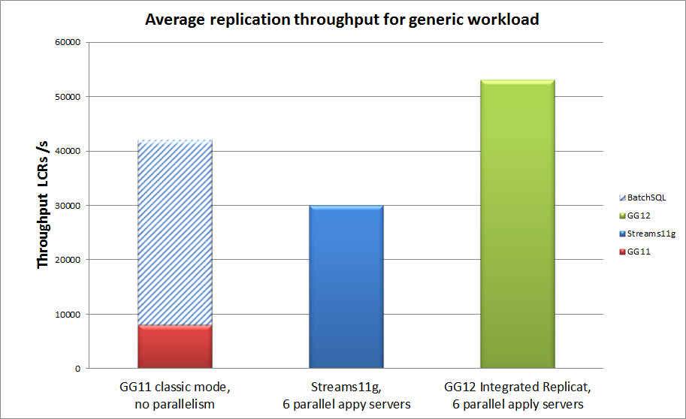
Performance measured @CERN
Generic workload (on the same hardware)
Workload description:
30M of DMLs (10M ins, 10M upd ,10M del)
10GB of redo volume
100k of transactions
RDBMS 11.2.0.1
RDBMS 11.2.0.1
RDBMS 12.1.0.1

Slide 40
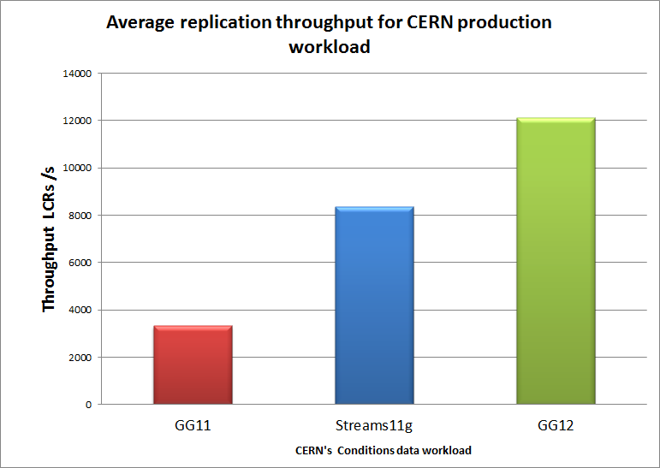
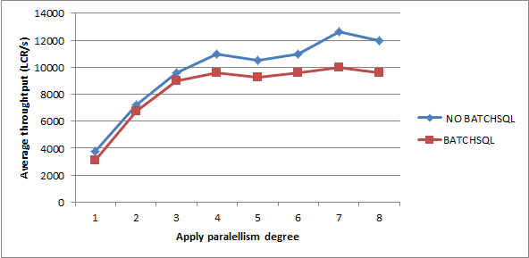
Performance measured @CERN
Production workload (same hardware)
Workload description:
5 days of ATLAS conditions data
675GB of redo volume
260k of transaction
18.9 M of row changes (LCRs)
BatchSQL has no effect for us
No advantages from using BatchSQL
No apply parallelism
Bottleneck: IO & txns dependency
Bottleneck: IO & txns dependency
Tune BATCHTRANSOPS (default 50)

Slide 41
In-database monitoring
  Status and statistics available in db views
  GoldenGate performance advisory (SPADV for GG)
  GoldenGate statistics in AWR
    available since RDBMS 12.1
  Health Check report

Slide 42
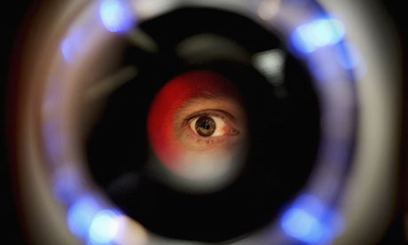
GG db views
Integrated Extract
  DBA_CAPTURE & V$GOLDENGATE_CAPTURE
    details about log miner session (state, progress, etc)
  DBA_GOLDENGATE_SUPPORT_MODE
    Check if schema tables are supported by GG
Integrated Replicat
  DBA_APPLY – config and process status
  V$GG_APPLY_RECEIVER – LCR received from replicat for processing
  V$GG_APPLY_READER – LCR-level statistics
  V$GG_APPLY_COORDINATOR – transaction-level stats
  V$GG_APPLY_SERVER – status of transactions being applied
  V$GOLDENGATE_TABLE_STATS
    Change counters for all tables

Slide 43
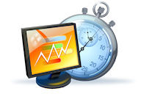
Monitoring performance
Streams performance advisory available for GG
  0) Deploy:
  @?/rdbms/admin/utlspadv.sql
  1) Run monitoring:
  UTL_SPADV.START_MONITORING
  2) Stop monitoring:
  UTL_SPADV.STOP_MONITORING
  3) Generate report
  UTL_SPADV.SHOW_STATS_HTML
  UTL_SPADV.SHOW_STATS

Slide 44
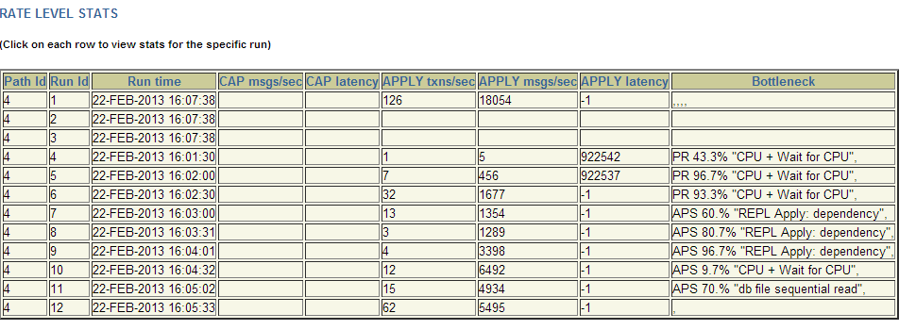
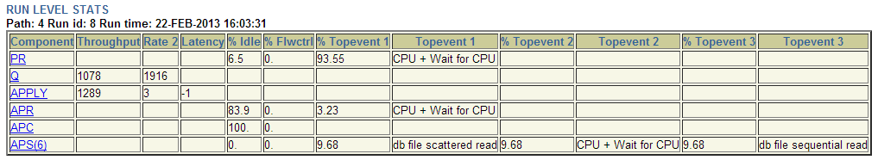
Monitoring performance
SPADV performance report
  1) Run monitoring

Slide 45
Health Check
Doc ID 1448324.1
Dump of detailed configuration
  DB & GG process parameters etc.
  Topology
All what MOS needs for diagnostic
  Inappropriate configuration notifications
  Wait event analysis
  Statistics
  Errors
available for >=11.2.0.4

Slide 46
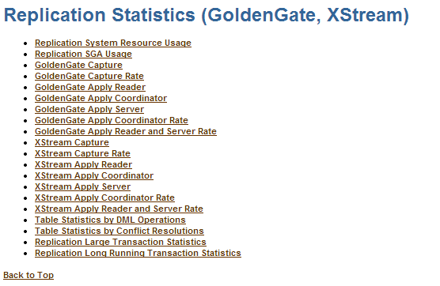
GG in AWR report (12c)

Slide 47
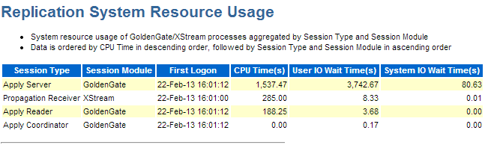
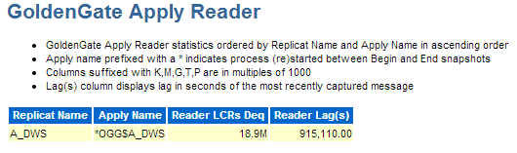
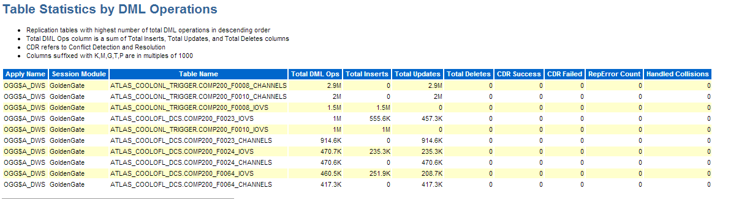
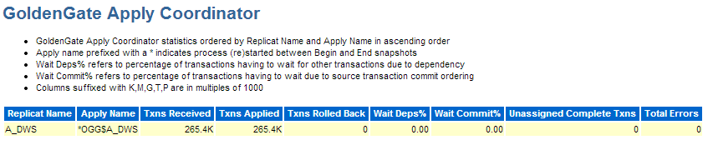
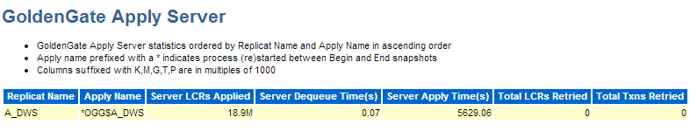
GG in AWR report (12c)
Is my replication IO or CPU bound?
How many DML changes on tables?
How many LCRs have we received from source and with what latency?
How many transactions?
How many errors?
How many LCRs applied?

Slide 48

Other features that we are interested in
Data consistency
  Veridata
  Conflict Data Resolution (CDR)
Monitoring
  OGG Director
  EM plugin

Slide 49
Outline
About CERN
CERN’s replication service based on Streams
Evaluation of GoldenGate…
…including the latest version
Summary

Slide 50
Summary
Streams in 11g are mature and reliable
  but will not be enhanced!
GoldenGate keeps evolving!
  A lot of (good) features inherited from Streams
  Improved scalability - performance better than Streams
  Easier deployment, data instantiation and administration
  Availability of in-database monitoring and reporting
  More data types supported
We gained a lot of experience by running Streams
  We can use that knowledge for GoldenGate

Slide 51



Are we ready for it?
(Native) DDL replication
  Table creation, granting of user privileges
Data filtering on schema and table name level
Remote configuration and management of replication processes
Source database offloading
DDL handler at target database
  Automatic tablespace creation on replica
Proactive and reactive monitoring

Slide 52
What next?
We are planning to migrate from Streams to GG12c next year (2014)

Slide 53
Acknowledgements
CERN Database group
  Especially: Lorena Lobato Pardavila
Oracle
  Patricia McElroy
  Jagdev Dhillon
  Greg Doherty
  Monica Marinucci

Slide 54

THANK YOU!
zbigniew.baranowski@cern.ch

Slide 56
Streams11g vs GoldenGate 11.1 in 2011
Feature | Streams | GoldenGate
Architecture | embedded in RDBMS buffered queues (no I/O) Logmining server | external binaries trail files (no flow control) redo log parser
Deployment of technology | embedded in RDBMS using PL/SQL or EM | additional GG binaries to be installed configuration of each component though parameter files
Deployment in MAA | RAC and ASM supported transparent for DBA | RAC and ASM supported additional setting and configuration required
Operations supported | DML & DDL no additional configuration to be done | DML & DDL DDLs requires deployment (trigger + marker table in GG administrator schema) cross schema DDLs are not consistently executed
Data instantiation | data pump / transportable tablespaces tricky to perform ‘hot ’ schema instantiation | data pump / transportable tablespaces initial load (not so fast)
Performance | improved in 11g good rates observed for generic and CERN production workload optimizations: parallelism has significant impact on apply speed | very good with simple workload on single tables (optimizations works) not as efficient for CERNs production workload foreign constraints violation when using parallelism
Monitoring & Management | DBMS packages, dictionary views included in Enterprise Manager since 10g CERN uses its own tool | GGSCI – command line tool not yet included in Enterprise Manager Director (requires additional software WL) and Monitor (new tool)
Maintenance | regular shrinks of DB objects required (logminer tables and queue tables) dumps of dictionaries split & merge in case of replica failure | periodic removal of trail files (can be automatic) no action required in case of replica failure
Other | RDBMS Oracle license offloading primary system with downstream capture database | GoldenGate license required no solution for primary system offloading

Slide 57
Streams11g vs GoldenGate 12c
Feature | Streams | GoldenGate
Architecture | embedded in RDBMS buffered queues (no I/O) logmining server | external binaries trail files (no flow control) logmining server
Deployment of technology | embedded in RDBMS using PL/SQL or EM | additional GG binaries to be installed (can be done on remote server) configuration of each component though parameter files
Deployment in MAA | RAC and ASM supported transparent for a DBA | RAC and ASM supported transparent for a DBA
Operations supported | DML & DDL | DML & DDL more data types supported
Data instantiation | data pump / transportable tablespaces tricky to perform ‘hot ’ schema instantiation | data pump / transportable tablespaces initial load
Performance | good rates observed for generic and CERN production workload | faster them streams for generic and CERNs production workload
Monitoring & Management | DBMS packages, dictionary views included in Enterprise Manager since 10g CERN uses its own tool | GGSCI – command line tool included in Enterprise Manager Custom tool can be easily developed
Maintenance | regular shrinks of DB objects required (logminer tables) dumps of dictionaries split & merge in case of replica failure | regular shrinks of DB objects required (logminer tabs) dumps of dictionaries periodic removal of trail files (can be automatic) no action required in case of replica failure
Other | RDBMS Oracle license offloading primary system with downstream capture database | GoldenGate license required offloading primary system with downstream capture database

